Slide 1

CSE- 207
Algorithms
Lecture: 05
Fahad Ahmed
Lecturer, Dept. of CSE
E-mail: fahadahmed@uap-bd.edu

Slide 2
Chapter Outcomes
Introduction to Divide and Conquer (DAC).
Algorithms under DAC techniques.
Recurrence Relation for DAC algorithm.
Problems using DAC technique.
Strengths and weaknesses of a DAC strategy

Slide 3
Divide and Conquer
Divide and Conquer is an algorithm design paradigm / technique.
Divide and conquer approach has 3 steps
Division - the problem is divided into smaller sub-problems of similar type
Conquer -each sub-problem is solved independently.
Merge/Combine - The solution of all sub-problems is finally merged in order to obtain the solution of an original problem.
Approach:
- Recursion (Top-down approach)

Slide 4
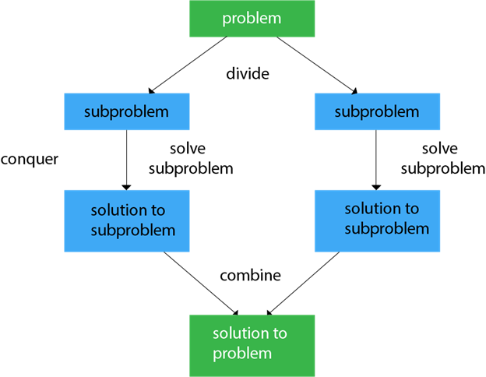
Divide and Conquer
How far should we divide?
When we keep on dividing until you reach a stage where no more division is possible or solution is straight forward.

Slide 5
Recurrence
A recurrence is an equation or inequality that describes a function in terms of its value on smaller inputs.
E.g. fact(n) = n*fact(n-1)
Recurrences are generally used in divide-and-conquer paradigm
Because both of them are described/solved in terms of a smaller problem.

Slide 6
Well-Known Uses
Searching
Binary search
Sorting
Merge Sort
Quick Sort
Mathematics
Polynomial and matrix multiplication
Exponentiation
Large integer manipulation
Points
Closest Pair
Merge Hull
Quick Hull

Slide 7
Example of Divide and Conquer
Binary Search
Divide- divide in to 2 halves and select lower of upper half
Conquer – Search in selected half
Combine – None
Merge Sort
Divide- divide in to 2 halves.
Conquer – Sort each half recursively.
Combine – Combine the 2 sorted list

Slide 8
Example of Divide and Conquer
Quick Sort
Divide – partition the array using pivot (Divide is the most important segment of quick sort)
Conquer – move smaller element to the left and bigger to right
Combine - None

Slide 9
Example of Divide and Conquer
Calculate power (x,n)
Divide – divide the power term n to half n/2
Conquer – Find the x^{n/2}
Combine – multiply the x^{n/2} with x^{n/2}
Find Minimum of an array
Divide – Divide the array into 2 halves
Conquer – Find the minimum of the 2 subArray
Combine – take the minimum of the minimum of 2 subarray

Slide 10
Calculate Power
Given two integers a and n, write a function to compute a^{n}.
We may assume that a and n are small and overflow doesn’t happen.
// Naive iterative solution to calculate `pow(a, n)`
long power(int a, int n)
{
long pow = 1;
// multiply `a` exactly `n` times
for (int i = 0; i < n; i++) {
pow = pow * a;
}
return pow;
}
The time complexity of the above solution is O(n).

Slide 11
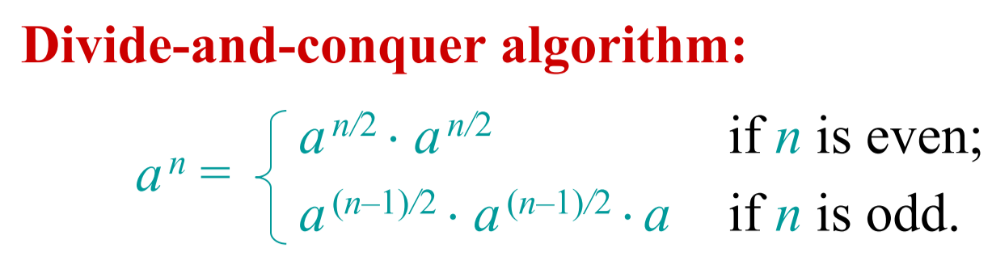
Calculate Power
Time Complexity of optimized solution: O(logn)

Slide 12
Calculate Power
Algorithmic Paradigm: Divide and conquer
long power(int a, int n)
{
if (n == 0) { // base condition
return 1;
}
if (n & 1) { // if `n` is odd
return a * power(a, n-1 / 2) * power(a, n-1 / 2);
}
// otherwise, `n` is even
return power(a, n / 2) * power(a, n / 2);
}

Slide 13
Calculate Power
Time Complexity of optimized solution: O(logn)
This function can be optimized to O(logn) by calculating
power(a, n/2) only once and storing it.
long power(int a, int n)
{
if (n == 0) {
return 1;
}
int temp = power (a, n/2);
if (n & 1) {
return a * temp* temp;
}
// otherwise, `n` is even
return temp* temp;
}

Slide 14
Binary Search

Slide 15
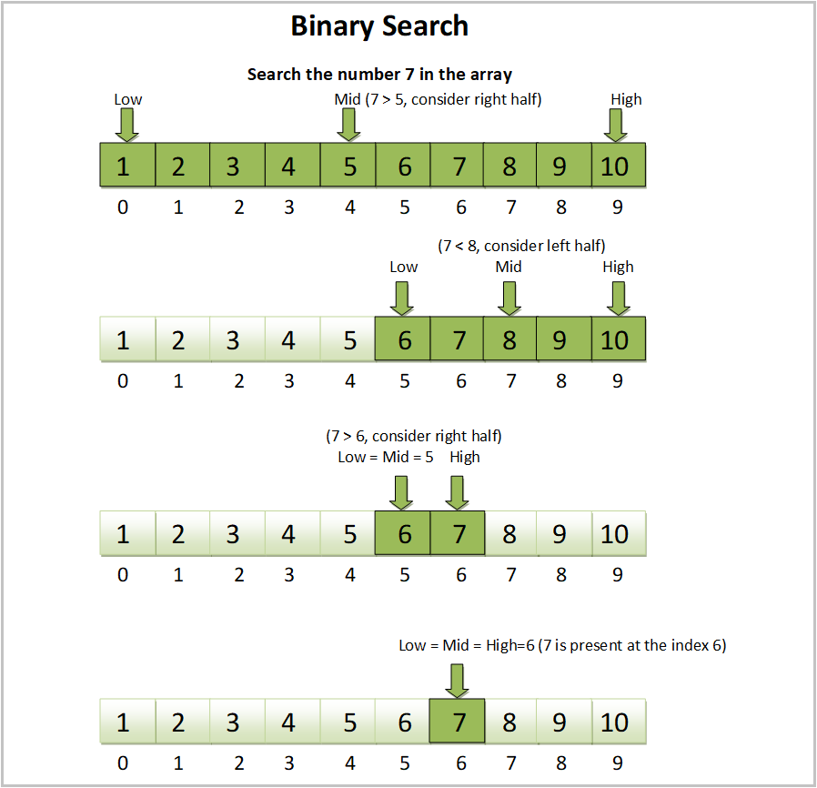

Slide 16
Binary Search
Binary-Search(A, low, high, item):
if (low>high) return false;
else
mid = (low+high)/2;
if (item == A[mid])
return true;
if(item<A[mid])
Binary-Search(A, low, mid-1, item)
else
Binary-Search(A, mid+1, high, item)
Same problem of size n/2
Same problem of size n/2

Slide 17
Binary Search – Time Complexity
For array of size n,
Time complexity is T(n)
Binary-Search(A, low, high, item):
if (low>high) return false;
else
mid = (low+high)/2;
if (item == A[mid])
return true;
if(item<A[mid])
Binary-Search(A, low, mid-1, item)
else
Binary-Search(A, mid+1, high, item)
constant time: c₁
constant time: c₂
constant time: c₃
Same problem of size n/2
So, Time Complexity= T(n/2)
Same problem of size n/2
So, Time Complexity= T(n/2)
So, Time Complexity T(n) = T(n/2) +C

Slide 18


Merge Sort

Slide 19
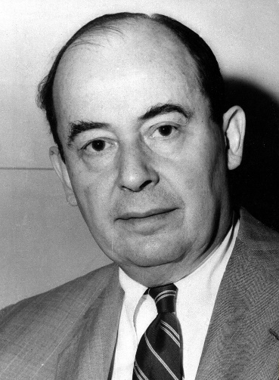
Merge Sort
Merge Sort was developed by John von Neumann in 1945.
Austria-Hungary A mathematician who made major contributions to set theory, functional analysis, quantum mechanics, continuous geometry, economics and game theory, numerical analysis, hydrodynamics.

Slide 20
Merge sort
merge sort: Repeatedly divides data in half, sorts each half, and combines the sorted halves into a sorted whole.
The algorithm:
Divide the list into two roughly equal halves.
Sort the left half.
Sort the right half.
Merge the two sorted halves into one sorted list.
Often implemented recursively.

Slide 21
Merge sort example
index | 0 | 1 | 2 | 3 | 4 | 5 | 6 | 7
value | 22 | 18 | 12 | -4 | 58 | 7 | 31 | 42
split
22 | 18 | 12 | -4
58 | 7 | 31 | 42
split
split
22 | 18
12 | -4
58 | 7
31 | 42
split
split
split
split
22
18
12
-4
58
7
31
42
merge
merge
merge
merge
18 | 22
-4 | 12
7 | 58
31 | 42
merge
merge
-4 | 12 | 18 | 22
7 | 31 | 42 | 58
merge
-4 | 7 | 12 | 18 | 22 | 31 | 42 | 58

Slide 22
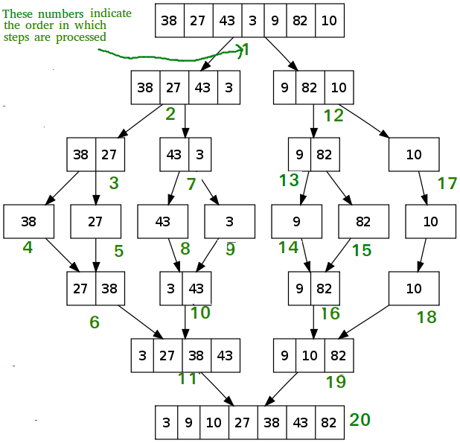
Merge Sort

Slide 23
Merge Sort
MergeSort (A, l, h)
If l <h
1. Find the middle point to divide the array into two halves:
middle m = (l+h) /2
2. Call mergeSort for first half:
Call mergeSort(A, l, m)
3. Call mergeSort for second half:
Call mergeSort(A, m+1, h)
4. Merge the two halves sorted in step 2 and 3:
Call merge(A, l, h, m)

Slide 24
Merge Sort
MERGE-SORT(A, l, h)
MERGE(A, low, mid, high)
1 n1 = mid – low + 1
2 n2 = high - mid
3 let L[0… n1] and R[0… n2] be new arrays
4 for i = 1 to n1
5 L[i ]= A[low+ i -1]
6 for j = 1 to n2
7 R[j]= A[mid+ j]
8 L[n1 + 1] = ∞ , R[n2 + 1] = ∞
9 i = 1, j = 1
10 for k = low to high
11 if L[i] ≤ R[j]
12 A[k] = L[i]
13 i = i + 1
14 else A[k] = R[j]
15 j = j + 1
1 if l < h
2 m = (l + h)/2
3 MERGE-SORT(A, l, m)
4 MERGE-SORT(A, m+1, h)
5 MERGE(A, l, h, m)

Slide 25
Merge Sort
MERGE-SORT(A, l, h)
T(n)
1 if l < h
2 m = (l + h)/2
3 MERGE-SORT(A, l, m)
4 MERGE-SORT(A, m+1, h)
5 MERGE(A, l, h, m)
c
T(n/2)
T(n/2)
O(n)
How??
Time Complexity, T(n) = c + 2T(n/2) + O(n)

Slide 26
Merge Sort
MERGE(A, low, mid, high)
1 n1 = mid – low + 1
2 n2 = high - mid
3 let L[0… n1] and R[0… n2] be new arrays
4 for i = 1 to n1
5 L[i ]= A[low+ i -1]
6 for j = 1 to n2
7 R[j]= A[mid+ j]
8 L[n1 + 1] = ∞ , R[n2 + 1] = ∞
9 i = 1, j = 1
10 for k = low to high
11 if L[i] ≤ R[j]
12 A[k] = L[i]
13 i = i + 1
14 else A[k] = R[j]
15 j = j + 1
O(n)
O(n)

Slide 27
Analysis – Divide and Conquer
Time Complexity, T(n) = c + 2T(n/2) + O(n)
For any Divide and Conquer algorithm if the original problem of size n is divided into a number of sub-problems, each of size n/b, then the running time T(n) can be expressed as the following:
Here,
c is a small constant and
D(n) is the time needed to divide the problem and
C(n) is the time needed to combine them back.

Slide 28
Analysis – Merge Sort
For Merge Sort
D(n) = (1)
a = 2
b = 2
c = 1
So, Time Complexity of Merge Sort

Slide 29
Analysis – Merge Sort
Or we can replace (1) with constant, c and (n) with cn. For small constant c, we can rewrite the whole equation as,

Slide 30
Merge Sort
Advantages:— Guaranteed to run in O(nlgn)
Drawbacks of Merge Sort
Slower comparative to the other sort algorithms for smaller tasks.
Merge sort algorithm requires an additional memory space of O(n) for the temporary array.
It goes through the whole process even if the array is sorted.

Slide 31
Strengths and Weaknesses of Divide-and-Conquer
Strengths:
Generally improves on Brute Force by one base efficiency class
Easy to analyse using the Recurrence Templates
Weaknesses:
Often requires recursion, which introduces overheads
Can be inapplicable and inferior to simpler algorithmic solutions

Slide 32
Reference
Introduction to Algorithms – Chapter 2.3

Slide 33

Thanks to All

